Slide 1
Setting up MongoDB – Approaches, Challenges, Solution
Jacob Celestine (jc2777)
Rahul Dev E (re263)
Rasika Hasamnis (rmh229)
Anirudh Negi (an721)
Group #2 – Data Stars

Slide 2
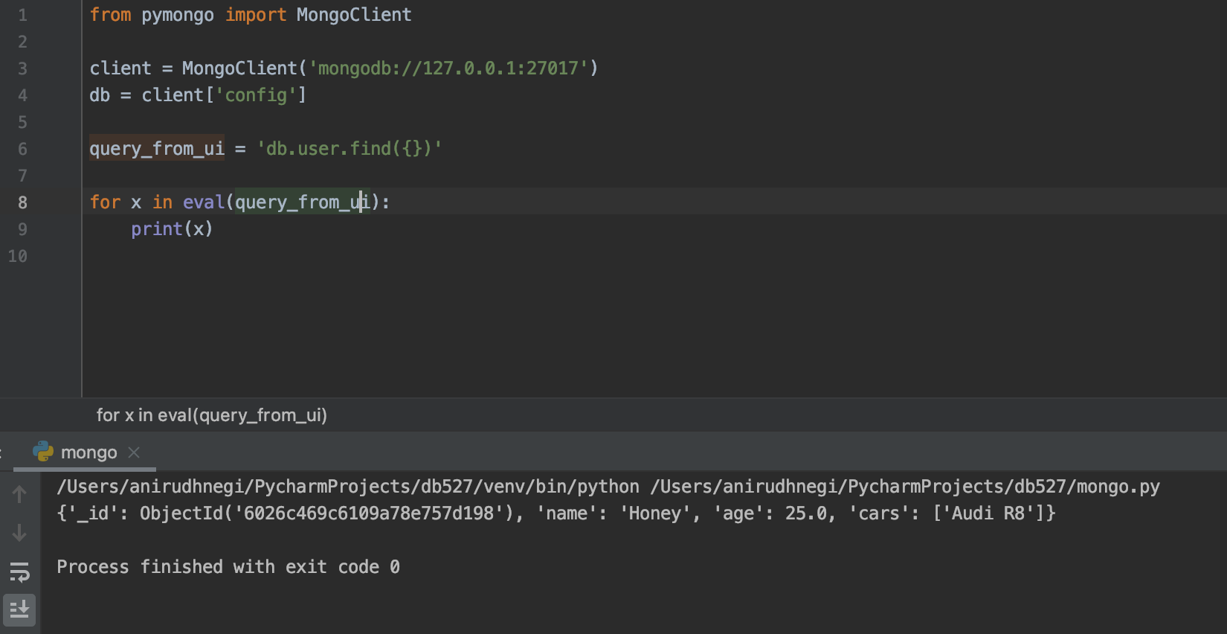
Approach #1 – Executing MongoDB commands in Python
Challenges:
If the input is just a MongoDB command, what would be easiest way to execute it? ☑
Can the package which executes this support SQL queries? ☒
What else can we do?

Slide 3
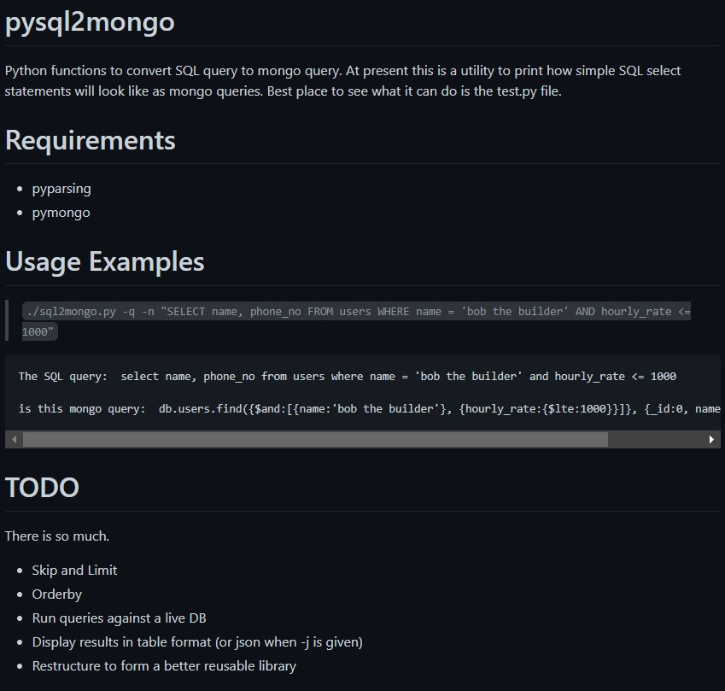
Approach #2 – Transform queries to commands
Challenges:
Could we convert the SQL queries to its corresponding mongo commands? ☑
How many transformations are supported? ☒
Is the package maintained? ☒
Alternatives?
https://github.com/martinslabber/pysql2mongo

Slide 4
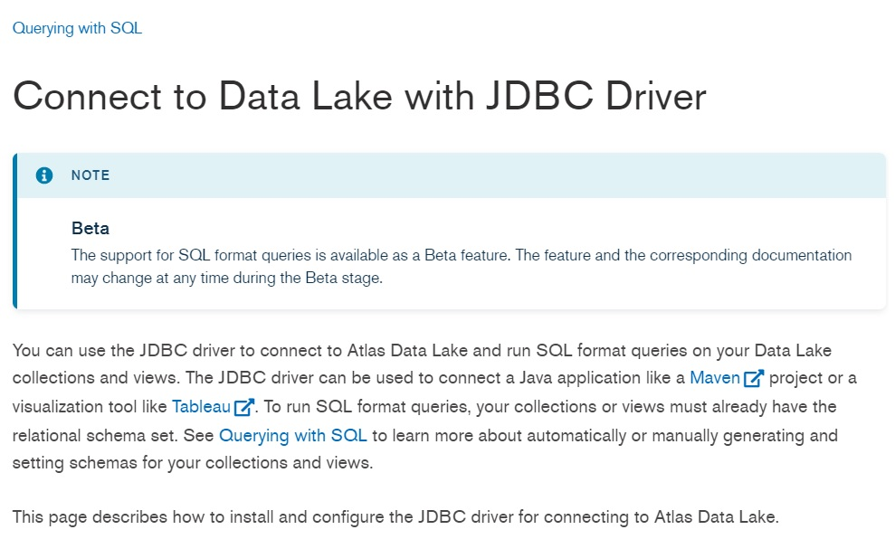
Approach #3 – Using a JDBC Driver
Challenges:
JDBC support for Python ☑
Could we set it up to work with mongo instance on EC2? ☒
Is the Driver trustworthy (Release or Beta)? ☒
Any other ways?
https://docs.mongodb.com/datalake/tutorial/jdbc-driver/

Slide 5
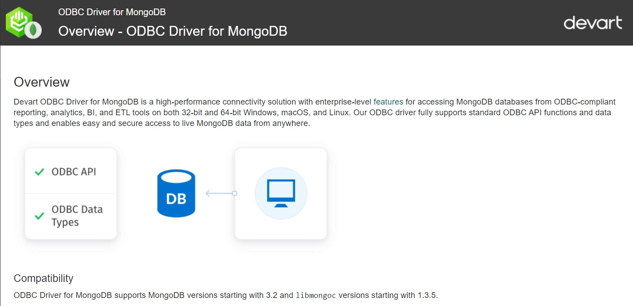
Approach #4 – Using an ODBC Driver
Challenges:
Could we set it up to work with mongo instance on EC2? ☑
How to use it with Python? ☑
Is the Driver trustworthy? ☑
Is it efficient? *
Is there an ODBC by MongoDB?
https://www.devart.com/odbc/mongodb/docs/overview.htm

Slide 6
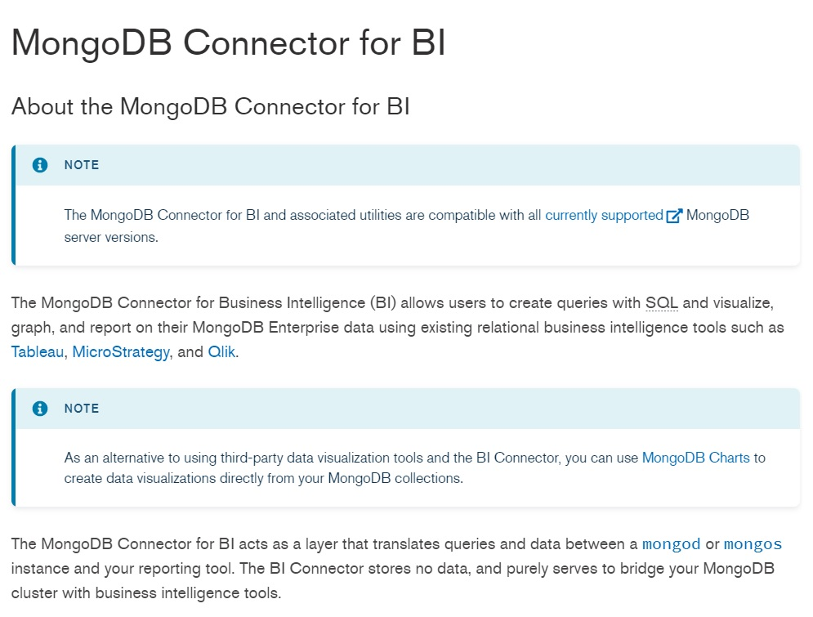
Approach #5 – An Official Connector?
Challenges:
Could we set it up to work with mongo instance on EC2? ☑
How to use it with Python? ☑
Is the Driver trustworthy? ☑
Is it efficient? ☑
Can it do all operations? ☒
Could we make the solution better?
https://docs.mongodb.com/bi-connector/current/
https://docs.mongodb.com/bi-connector/current/reference/mongosqld/

Slide 7
Challenges Faced with the Solution
Setting up the drivers was difficult due to lack of tutorials and resources.
Getting the setup running on free tier was extremely hard.
Devart ODBC driver was extremely slow when reading huge amounts of data, and even used up entire memory, leading to the webapp going down.
Also tried using the Devart ODBC on GCP with a higher configuration (8 vCPUs, 32 GB memory) to make sure the read function can work well with better resources.
BI Connector was extremely fast at reading and aggregation queries, but could not do any other operations.
BI Connector is also very restrictive in nature with regards to schema of the table.
Getting the combinations right, i.e., identifying the type of queries to figure out when to use which connector to use and when.

Slide 8
The Solution – Mix it Up!
DRIVER | Create | Update | Read | Delete
DEVART ODBC | ☑ | ☑ | Slow | ☑
Official Connector | ☒ | ☒ | ☑ | ☒
Inference: Using a combination of both drivers would yield the best result.
Using the pyodbc and MySQLdb package, we got it working!
☺

Slide 9
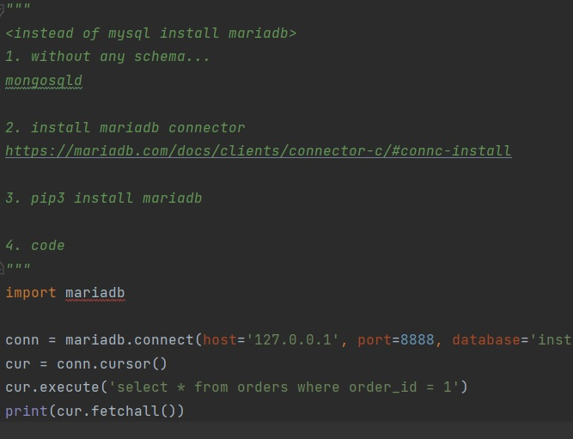
An Alternate
While setting up our flask app with the MySQLdb package, we also found an alternate way to use the BI connector.
Endless possibilities.

Slide 10
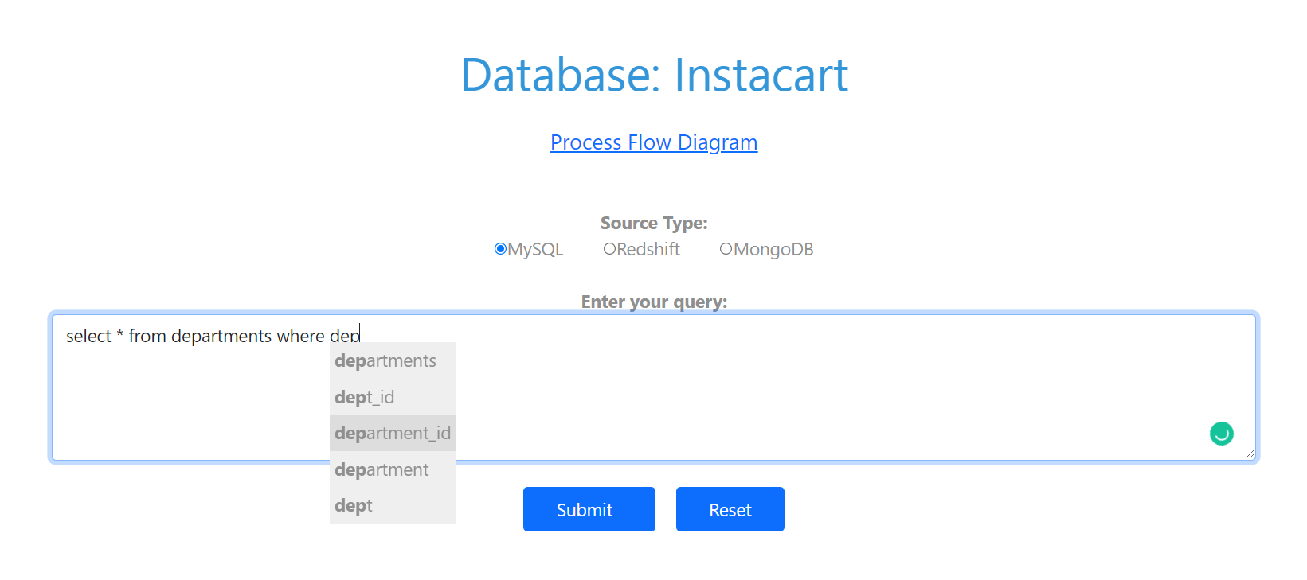
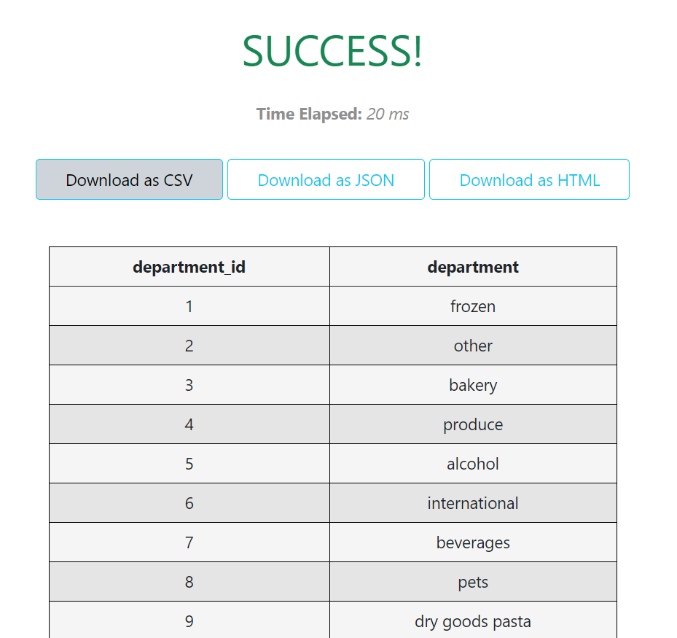
Additional Features
Auto complete SQL Queries!
Download the result as CSV, JSON and HTML

Slide 11

DEMO
READ
AGGREGATION
JOIN
CREATE
INSERT
UPDATE
DELETE
Using a Function
DROP

Slide 12

THANK YOU!

